Slide 1
Privacy and security preserving measures for federated learning in extremely resource constrained devices
Rubaiya Raktin Raha

Slide 2
Competing Constraints
Privacy
  Methods: DP, encryption, secure aggregation
  Concerns: Gradient leakage, inference attacks, backdoor attacks
Performance
  Model accuracy, convergence, speed
Resources
  CPU, Memory, battery (energy), bandwidth

Slide 3
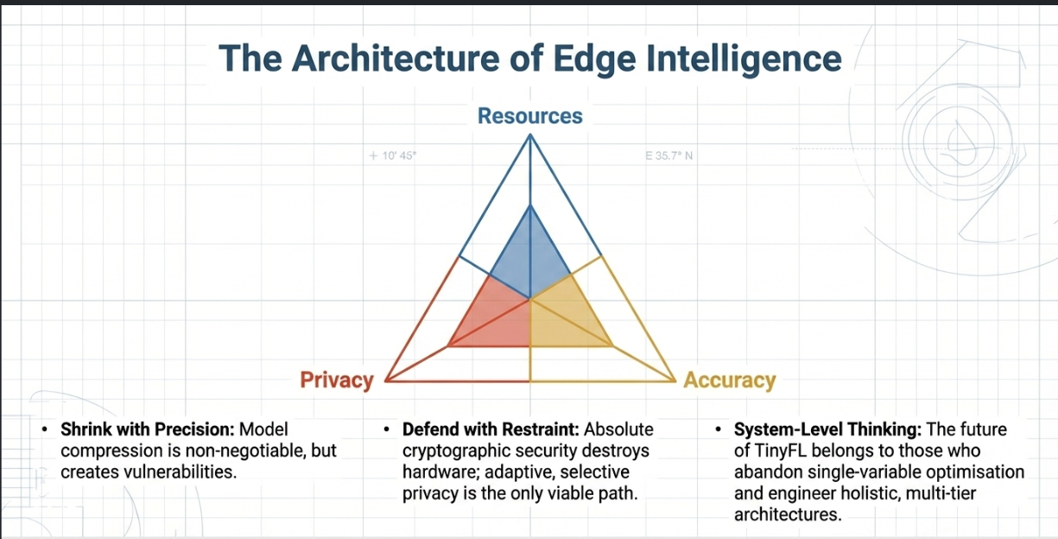

Slide 4
Problem 1 – Adaptive Privacy Mechanism
Problem:
most privacy methods are still too fixed; they do not adapt to client resource state, data size, or unstable participation, adaptive privacy mechanisms are still weakly validated on MCU-class hardware
Unique:
  Privacy overhead can exceed device capability
  Small local datasets make privacy noise more damaging.
  Some devices may not be able to afford the same privacy mechanism at all.
Research Question:
Fundamental: How can privacy be dynamically adjusted based on device or data conditions?
Iot specific: Can adaptive DP improve the privacy–utility–resource trade-off compared with fixed DP under heterogeneous client budgets and capability?
Goal:
Balance privacy and accuracy using adaptive strategies like -> Dynamically adjust DP noise / encryption level based on device resources

Slide 5
Approach for Problem 1
Implement FL model using TFF
Apply Differential Privacy (DP)
Introduce adaptive noise based on:
  Data size
  Simulated device capability ( low / nedium / high )
Evaluation:
Accuracy vs Privacy vs Convergence
Fixed noise vs Adaptive noise

Slide 6
Problem 2 – Resource-Aware privacy adaptation and participation
Problem:
Devices have different capabilities and availability,
privacy mechanisms add extra compute, communication, and energy overhead.
Participation affects privacy cost over time… so, who participates, when they participate, and with what privacy level becomes part of the privacy-design problem
Research Question:
How can clients participate efficiently based on resource constraints?
Goal: Enable privacy-aware resource-aware participation by deciding:
when a client should participate,
how often it should participate,
how many local epochs it should run,
and what privacy level it can feasibly support.

Slide 7
Approach for Problem 2
Simulate different client types:
Low resource → fewer epochs / skip rounds
High resource → full participation
Define participation strategies:
  Full participation (baseline)
  Resource-aware participation (proposed)
Evaluation:
Training time
Model accuracy
Communication rounds

Slide 8
Problem 3 – Communication vs Privacy Trade-off
Problem:
Privacy mechanisms increase communication overhead, Communication-efficient methods already exist, But the co-design gap remains.
Research Question:
How can communication be reduced while preserving privacy? can privacy and communication reduction be designed together?
Can communication-aware privacy support (for example, sparsified/clipped updates plus DP, or privacy-aware client participation) reduce communication overhead without unacceptable loss of accuracy or privacy?
Goal:
Design or adapt privacy-preserving methods that are communication-efficient and feasible for resource-constrained IoT/TinyML devices.

Slide 9
Approach for Problem 3
Implement standard FL
Add: Gradient clipping / sparsification (send fewer updates)
Add DP noise (Starting with lightweight encryption )
Evaluation:
Communication size
Accuracy
Privacy level ( epsilon )

Slide 10
Overall Approach
Baseline 0 -> Standard FL
Baseline 1 -> FL + fixed DP
Proposed Variant 1
-> FL + clipped/sparsified updates + DP
Proposed Variant 2
-> FL + DP + resource-aware participation
Proposed Variant 3
-> FL + DP + compression + resource-aware participation
Phase A
  Build a standard FL baseline + adaptive DP
Phase B
  DP + selective client participation
  only some clients transmit in each round,
Phase C
  DP + sparsification / clipping

Slide 11


